Slide 1
Welcome
Apache Kafka
Presented By-Aishwarya s. shirse
Guided By-prof.Amruta joshi

Slide 2

Introduction
apache kafka is an open source stream processing software.
Distributed, replicated, scalable, durable, and gives high throughput.
It is written in scala and java.
Aim – “central nervous system for data”
It supports both queue and topic semantics.
It handles millions of messages.

Slide 3
Kafka is run as a cluster on one or more services that can span on multiple data centers.
Kafka is a open-source message broker project .
The design is heavily inﬂuenced by transaction logs.
Built at LinkedIn with a speciﬁc purpose in mind: to serve as a central repository of data streams.
open-sourced in 2011 under the Apache Software Foundation.
Apache top level project since 2012.

Slide 4
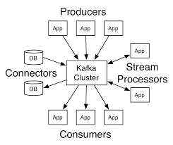
Kafka has 4 core APIs:
Producer API
Consumer API
Streams API
Connector API

Slide 5



Real Time Applications
Twitter
LinkedIn
Netflix

Slide 6
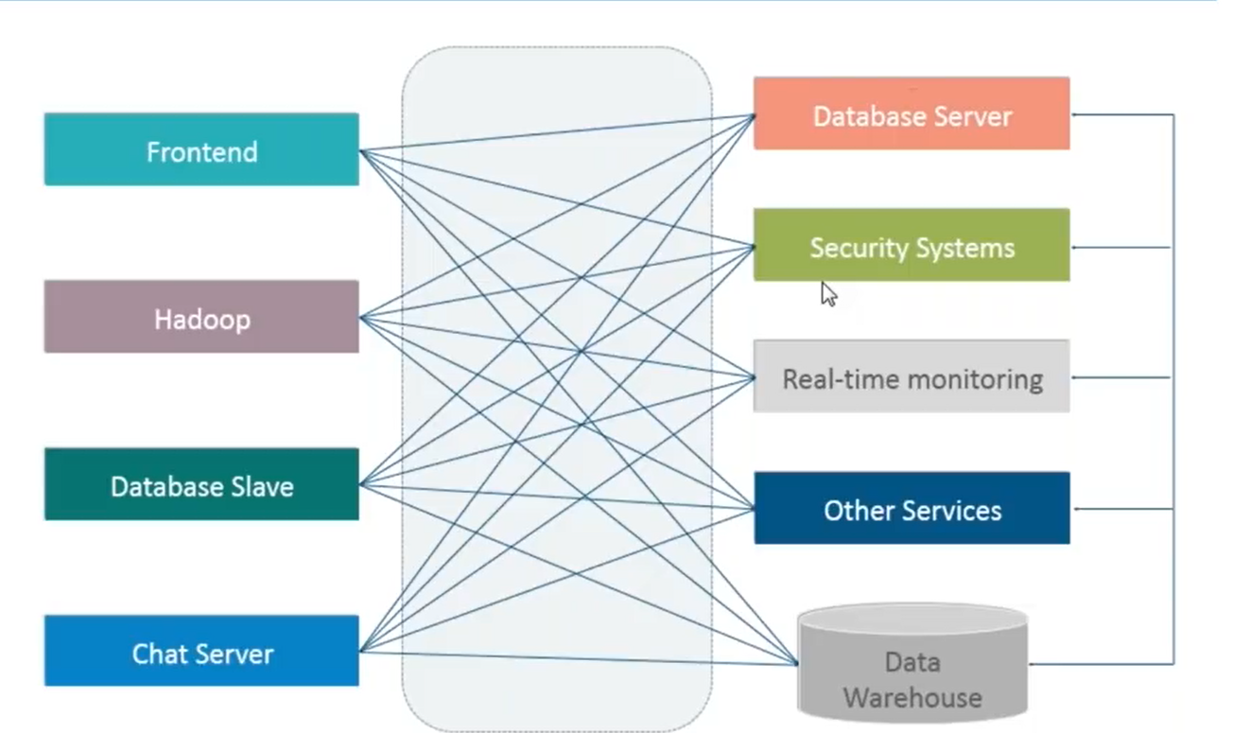
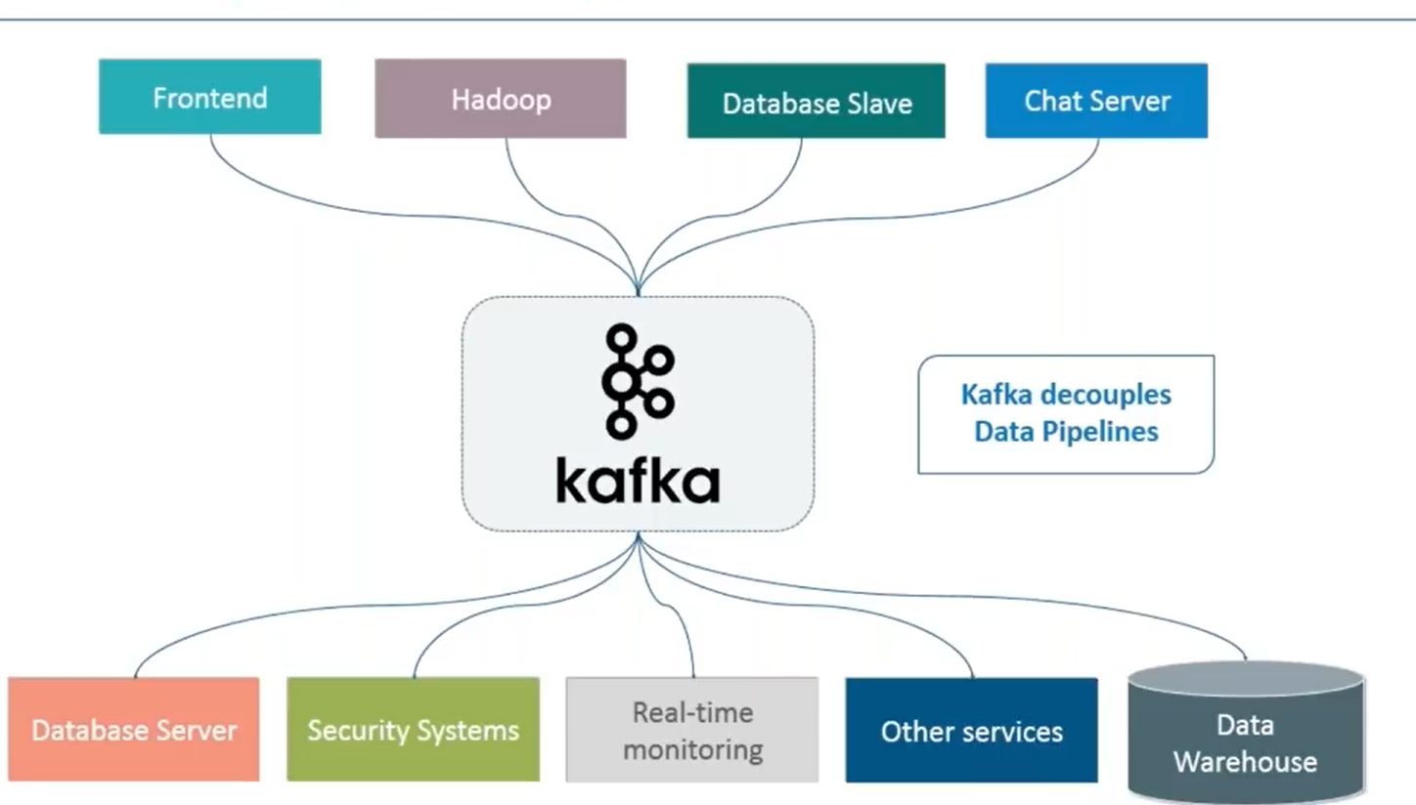
About apache kafka

Slide 7
Literature Survey
Kafka's origin story at LinkedIn.
What Kafka doesn't do?
Kafka and big data at web-scale companies.
Even slow-to-evolve enterprises are noticing Kafka.

Slide 8
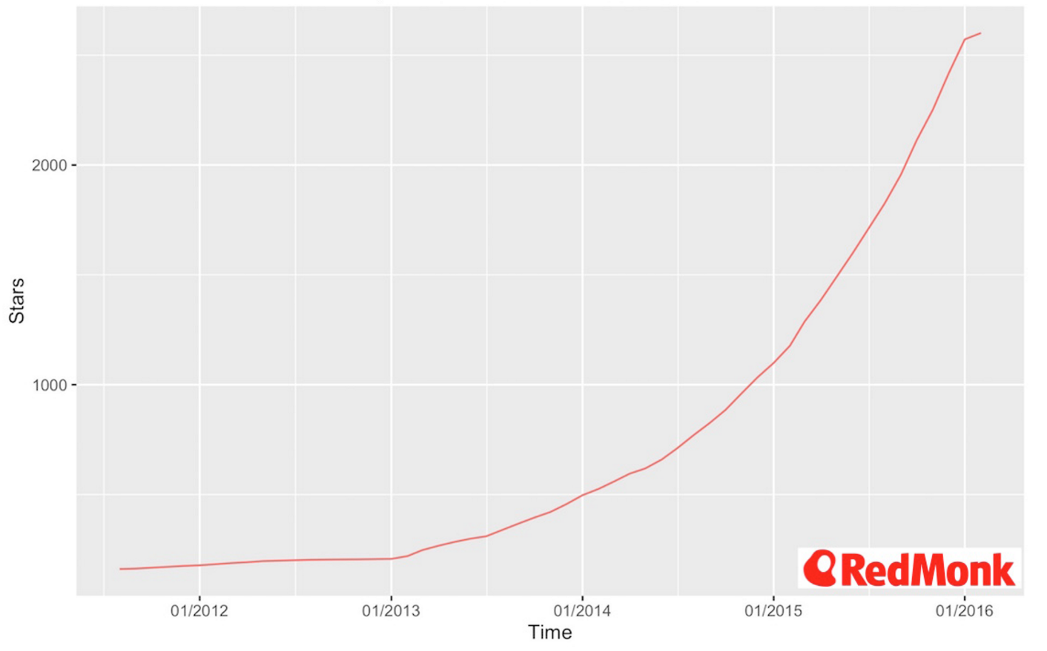
Kafka supports microservices.
How does Kafka compare to traditional messaging competitors?
Should you use Kafka?
Apache Kafka GitHub Stars Growth.

Slide 9
THANK YOU

